Slide 1
Investigating Learning Dynamics of BERT Fine-Tuning
A report for Cse431 NLP Individual Assignment 4 by Asef Hassan Amiz
ID 16321088

Slide 2
About
Investigating Learning Dynamics of BERT Fine-Tuning
Thesis Research by -
Yaru Hao , Li Dong , Furu Wei, and Ke Xu
From Beihang University
Microsoft Research

Slide 3

Abstract
They inspected the learning dynamics of BERT fine-tuning with two indicators. The JS divergence indicator to detect the change of the attention mode and the SVCCA distance indicator to examine the change to the feature extraction mode during BERT fine-tuning.
They also analyzed the consistency of BERT fine-tuning between different random seeds and different datasets.

Slide 4
Introduction
BERT
Indicators for investigating the learning dynamics of BERT
Bidirectional Encoder Representations from Transformers (BERT in short) is a large pre-trained language model which obtains state-of-the-art results on a wide array of Natural Language Processing (NLP) tasks
There are two approaches to adapt the pretrained language representations to the downstream tasks. One is the feature-based approach, and the other is the fine-tuning approach,
They investigated the learning dynamics of BERT fine-tuning with two indicators. -
Jensen-Shannon divergence to measure the change of the attention mode during BERT fine-tuning.
Singular Vector Canonical Correlation Analysis (SVCCA; Raghu et al. (2017)) distance to measure the change of the feature extraction mode

Slide 5
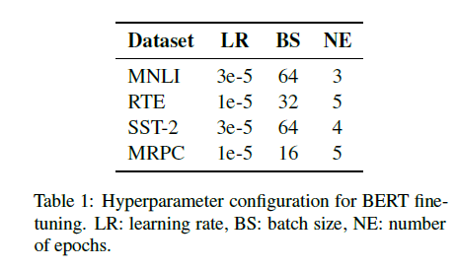
The Experimental Setup
They employed BERT-large model on 3 Diverse NLP Tasks -
Natural language inference (NLI), 2. Sentiment analysis (SA) , 3. Paraphrase detection (PD)
Data Sets they Used-
Multi-Genre Natural Language Inference (MNLI) and the Recognizing Textual Entailment(RTE) for NLI
Binary version of the Stanford Sentiment Treebank (SST2) for Sentiment Analysis
Microsoft Research Paraphrase Corpus(MRPC) for Paraphrase detection

Slide 6
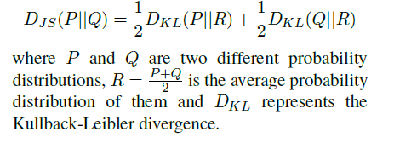
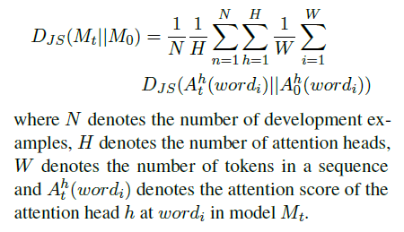
The Jensen-Shannon divergence
JS Divergence is a method of measuring the distance between two probability distributions
They computed the JS divergence of attention scores between the original BERT model M0 and the fine-tuned model Mt using this formula -

Slide 7
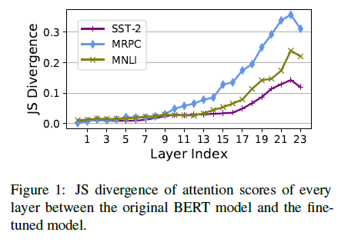
The JS Divergence Graph of Attention scores between Original & Fined tuned Model

Slide 8
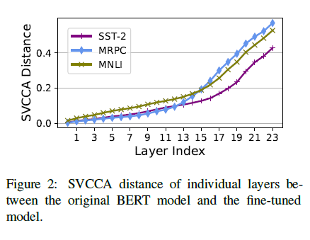
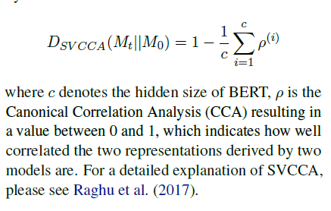
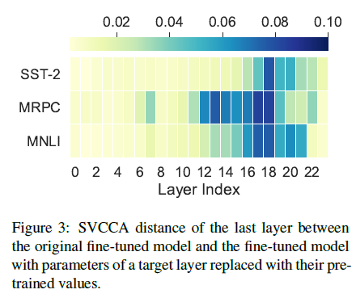
Singular Vector Canonical Correlation Analysis
SVCCA distance is used as a metric to measure
the differences of hidden representations between the original BERT model M0 and the fine tuned model Mt at a target layer

Slide 9
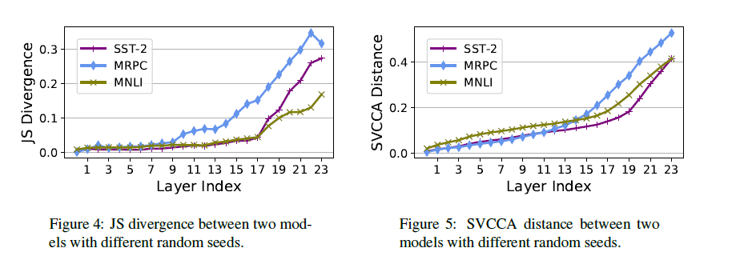
Consistency of Fine-tuning
Consistency between different random seeds

Slide 10
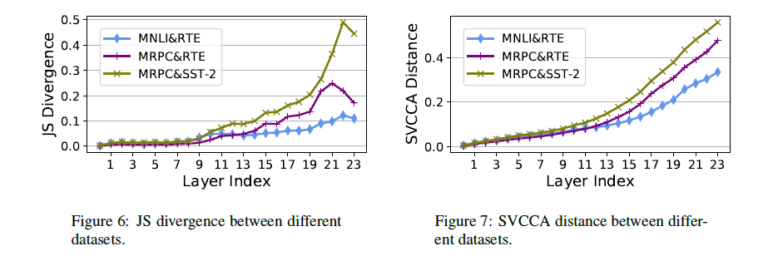
Consistency of Fine-tuning
Consistency between different datasets

Slide 11
Other Related Tasks
Pre-trained language models (Radford et al., 2018; Devlin et al., 2019; Liu et al., 2019; Dong et al., 2019; Yang et al., 2019; Clark et al., 2020; Baoet al., 2020) stimulate the research interest on the interpretation of these black-box models.
Peters et al. (2018b) show that the biLM-based models learn representations that vary with network depth, the lower layers specialize in local syntactic relationships and the higher layers model longer range relationships.
Kovaleva et al. (2019) propose a methodology and offer the analysis of BERTs capacity to capture different kinds of linguistic information by encoding it in its self-attention weights.
Hao et al. (2019) visualize the loss landscapes and optimization trajectories of the BERT fine-tuning procedure and find that low layers of the BERT model are more invariant and transferable across tasks. Merchant et al. (2020) find that fine-tuning primarily affects the top layers of BERT, but with noteworthy variation across tasks.
Hao et al. (2020) propose a self-attention attribution method to interpret information flow within Transformer.

Slide 12
Conclusion
They used JS divergence to detect the change of the attention mode in different layers during BERT fine-tuning
They used SVCCA distance to detect the change of the feature extraction mode
They observed that BERT fine-tuning mainly changes the attention mode of last layers and modifies the feature extraction mode of intermediate and last layers.
They also demonstrate that the changes of low layers are consistent between different random seeds and different datasets, which indicates that BERT learns common transferable language knowledge in low layers.

Slide 13
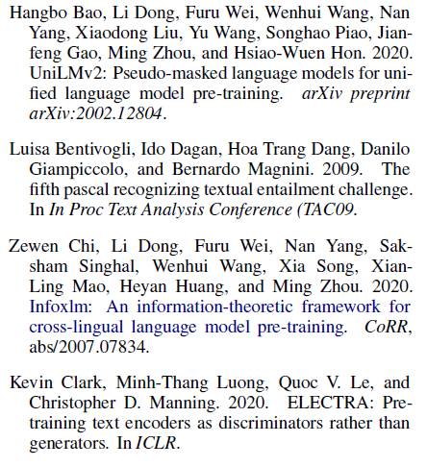
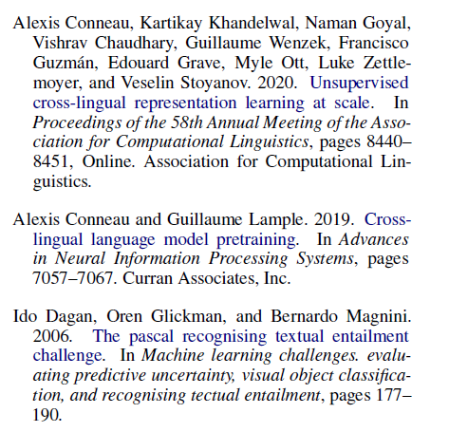
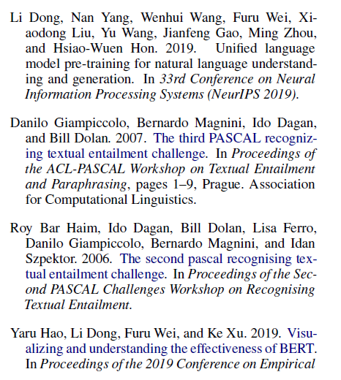
References

Slide 14

Student ID

